Slide 1

Garbage In, Insights Out
A Compost Command Lines Report
A Presentation by Jenn, Jocelyn, Joseph, Kyle

Slide 2
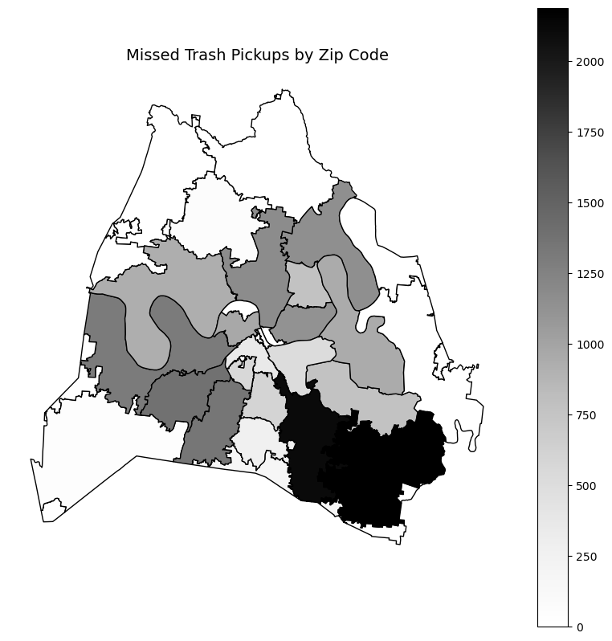
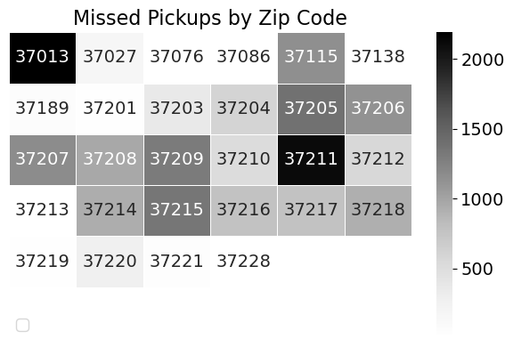
Oops, We Missed You: Pickups Gone Missing by Zipcode
“When the truck skips town, the data doesn’t.”
Notes:
Kyle: Total fines per zipcode (heatmap)

Slide 3
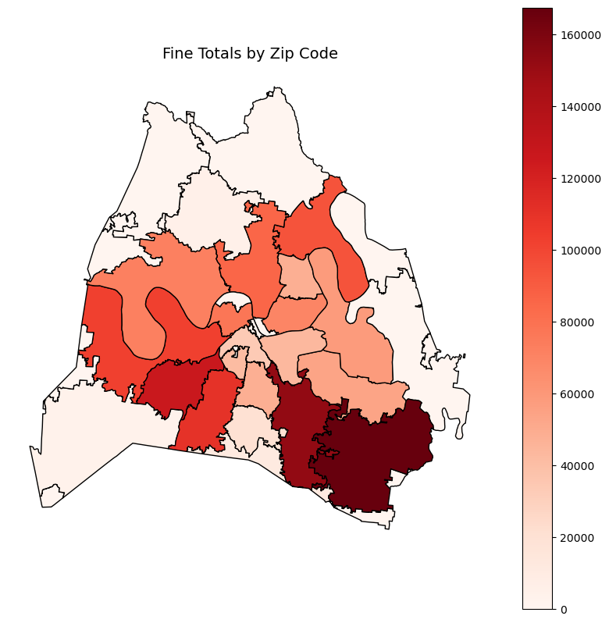
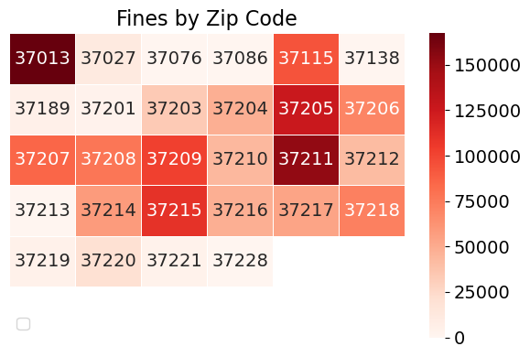
The Price of Trash: Fines Across the Map
“Every slip-up leaves a paper trail—and a price tag.”
Notes:
Kyle: Total fines per zipcode (heatmap)

Slide 4
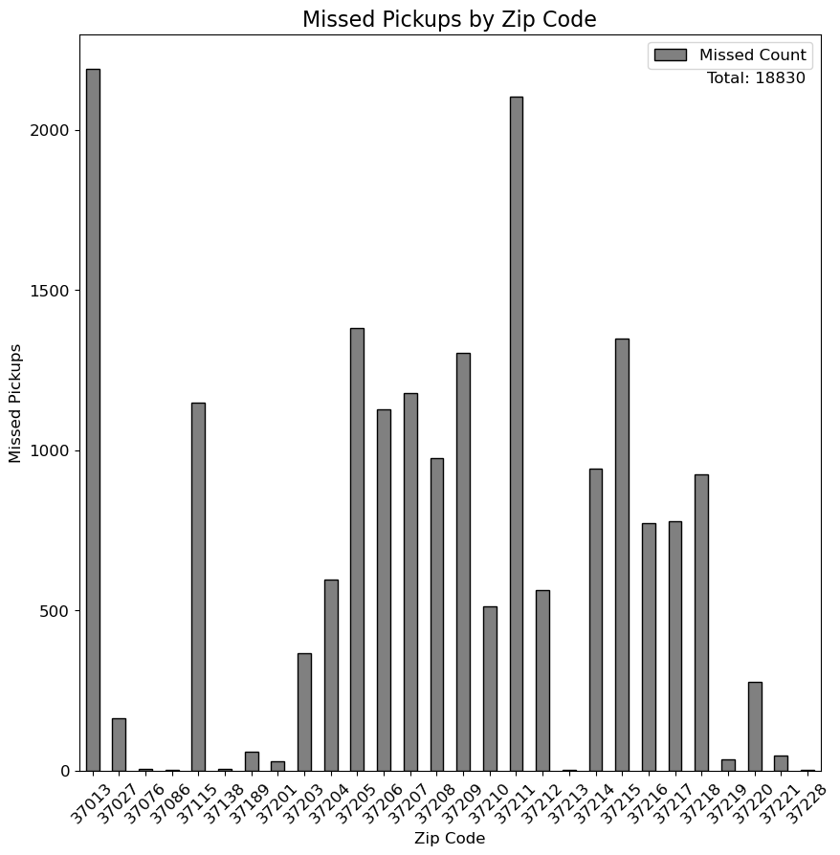
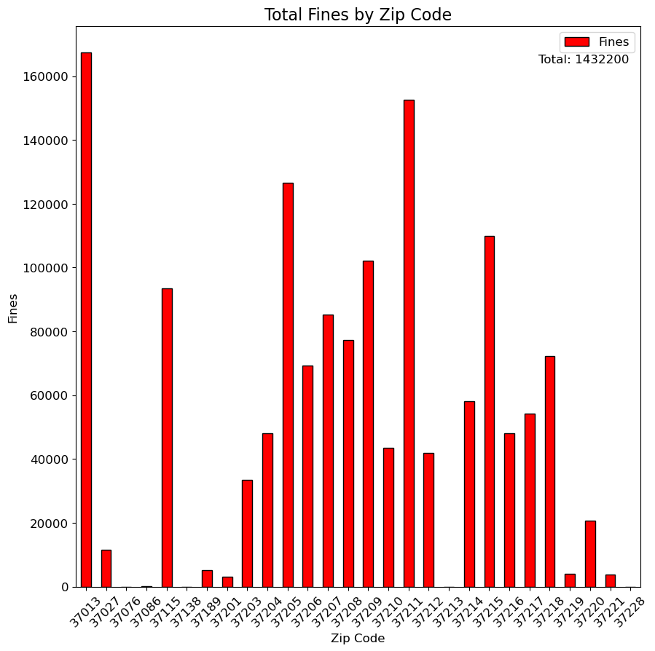
Breaking the Bank: Damages That Add Up
“Because trash trucks aren’t supposed to double as wrecking balls.”
Notes:
Kyle: Total amount of damages

Slide 5
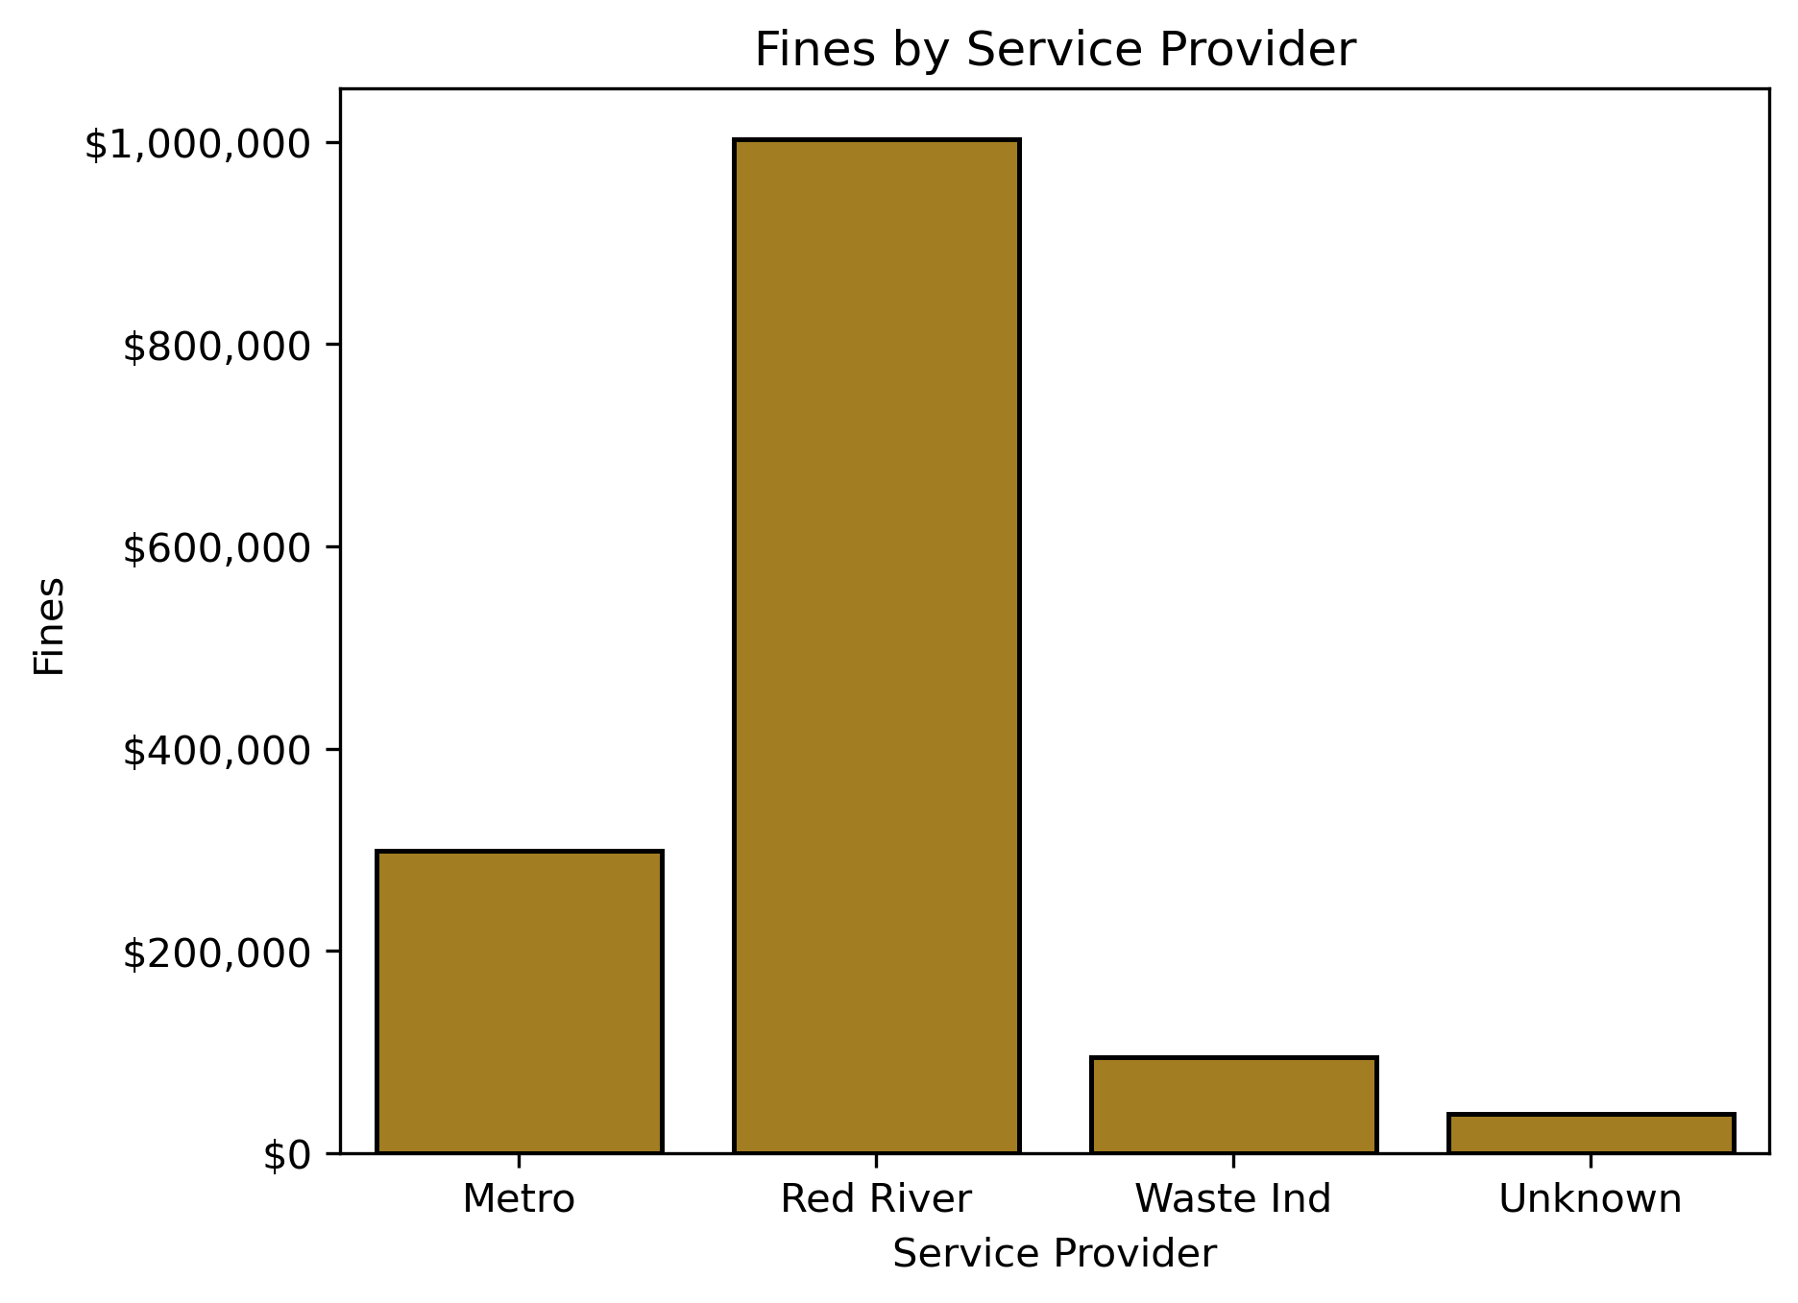
Buried in Bills: A Hauler’s Debt Load
“When garbage piles up, so do the invoices.”
Notes:
Joseph: How much does each trash hauler owe?

Slide 6
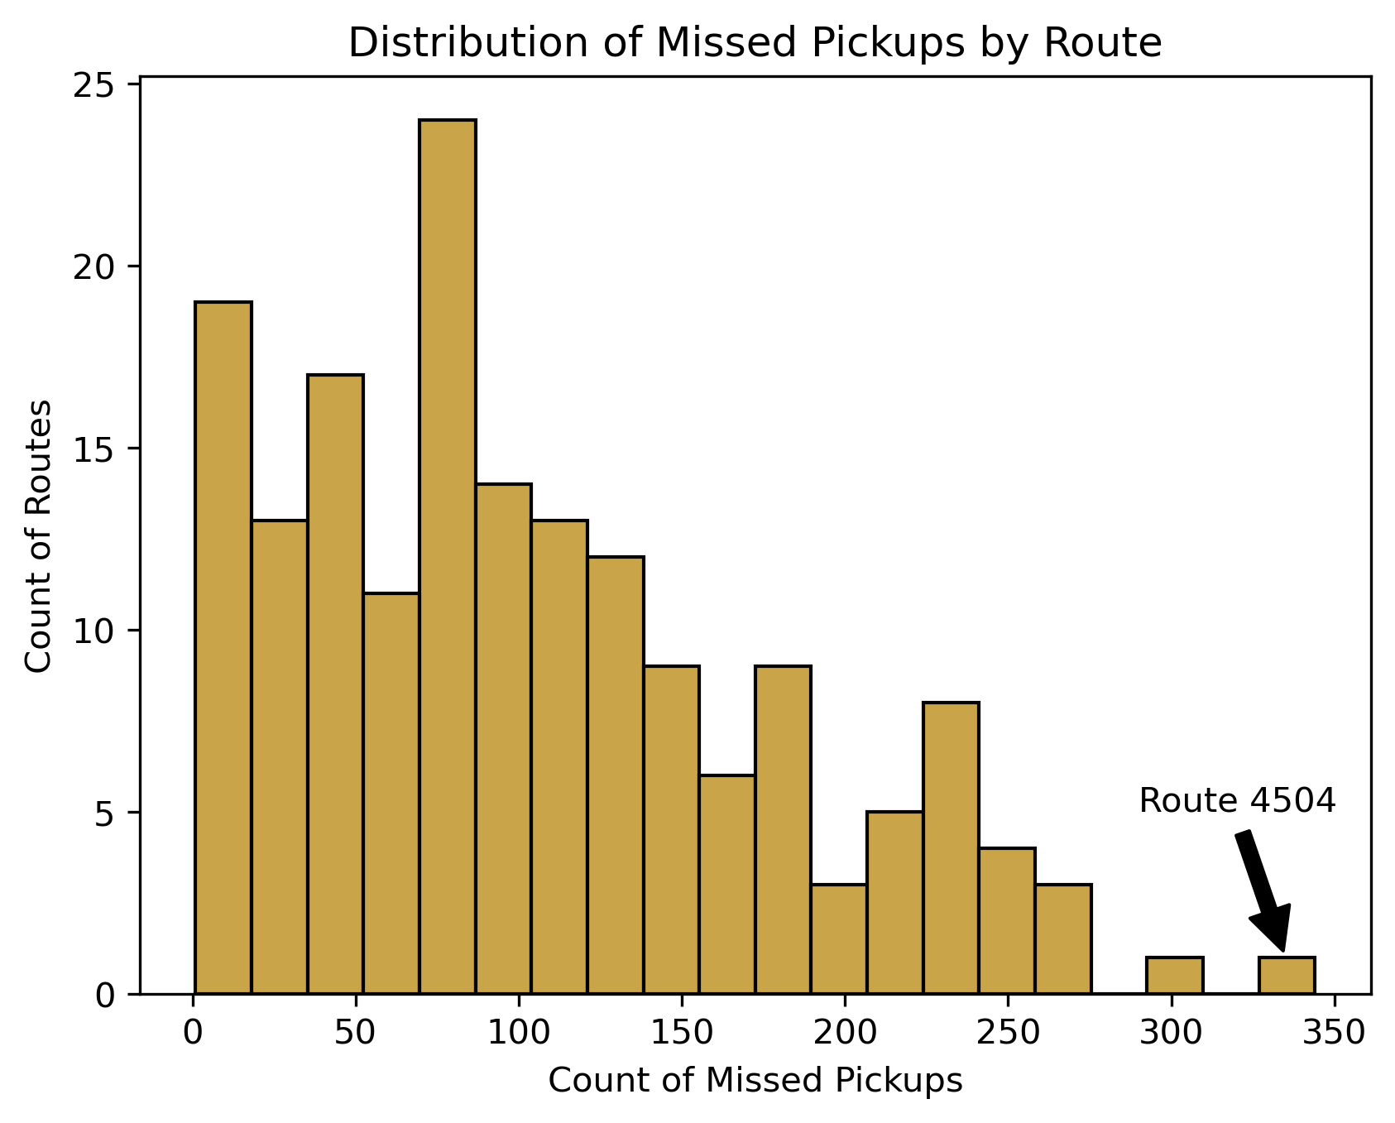
Detours & Do-Overs: Missed Pickups by Route
“Some roads lead to trash… others, apparently, don’t.”
Notes:
Joseph: Total missed pickups by route

Slide 7
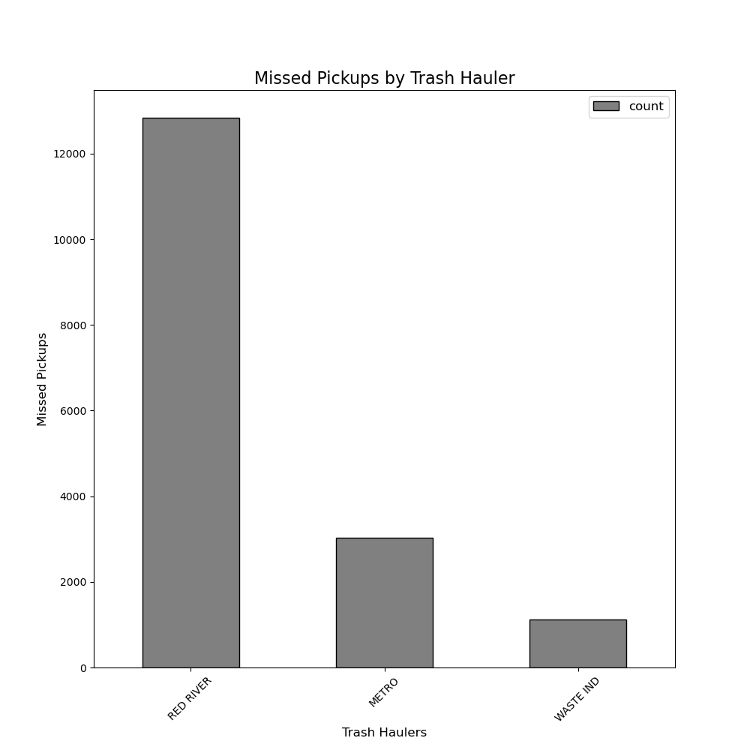
Head-to-Head: Cities vs. Contractor Showdown
Trash Hauler Missed Pickups
Red River 12846
Metro 3025
Waste 1129
“Who’s hauling their weight—and who’s just along for the ride?”
Notes:
Jocelyn: How do metro crews compare to the contractor's performance?

Slide 8
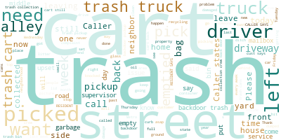
Trash Talk: Complaints Beyond the Pile
“Trash truck ran a red light through a school zone”
“Trash trucks leaking hazardous waste”
“Left message on cart for driver to come to door so they could wish happy holidays”
“cart left at street, and she has backdoor service”
Trash/crew dump the whole cart in the street and litter. Wants this to be reported.
“MICHAEL DESERVES A RAISE. He has helped me TWICE now when I forget to put the trash out. He’s awesome and he made my morning. He at least deserves a compliment/hug/high five. He’s awesome!!!! ”
“Proof that when it comes to garbage, everyone has something to say.”
Notes:
Missed pick ups and damages are important to call and report on, but here, we can see a word cloud pertaining to other complaints that have been made. We can see that trash and cart are the largest. This is because the larger the word, the more often it was found in the complaint section; on the contrary, the smaller the word, the less times it was found. This can be especially helpful to identify other areas that may be in need of improvement. Such as, topics like supervisor, time, driver, backdoor. While these words are not quite as large, it still may be a topic worth investigating to potentially be addressed in the future.
**3-4second break**
To the right in the honey comb graphic, I have listed a few other complaints that were documented but do not pertain to missed pick ups or damages. The bottom two being *COMPLIMENTS*. I enjoyed finding compliments because as someone who has worked with the public, I know how challenging it can be. So here we have it, proof that when it comes to garbage, everyone has something to say.

Slide 9

Thank you for talking Trash with us
Notes:
Jenn: What other types of complaints are there?

